Slide 1

Factors Influencing Mental Health Treatment Seeking Among Employees By Serge Nane DSC 530 EDA Winter 2024 – 2025

Slide 2

Why this topic?
Mental health is a critical issue in the workplace, affecting employee well-being, productivity, and overall organizational performance.
Understanding the factors influencing employees’ decisions to seek mental health treatment is essential for developing effective workplace interventions.
This Photo by Unknown Author is licensed under CC BY-ND

Slide 3

Project data
Goal of Project:
This project aimed to answer the question: "What factors influence the likelihood of seeking mental health treatment among employees?“
Dataset:
Source: https://www.kaggle.com/code/shreyaspj/mental-health?select=survey.csv
Variables: treatment, family history, Age, Gender, work interfere, number of employees.

Slide 4

Data Cleaning
To ensure data are good and consistency for analysis, we proceed to:
Handled missing values (e.g., imputed with mode/mean).
Removed invalid ages (e.g., negative or extremely high values).
Standardized Gender values (Male, Female, Other).
Encoded categorical variables (e.g., work_interfere, no_employees).

Slide 5

Exploratory Data Analysis (EDA)
To understand the distribution and relationships between variables
Variables Analyzed:
Age: Right-skewed distribution, mean = 32.08, min = 18, max = 72.
Gender: Most common = Male.
Family History: Most common = No.
Work Interfere: Most common = Sometimes (2.0).
Number of Employees: Most common = 26-100 employees (3.0).

Slide 6

DATA VISUALIZATIONS

Slide 7
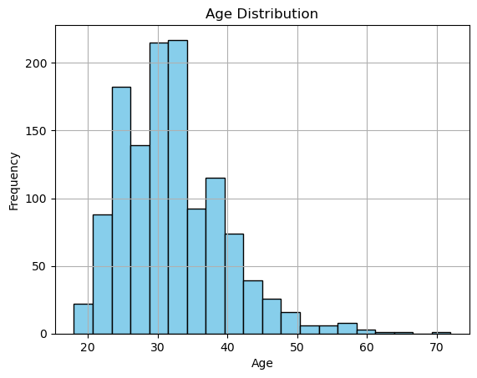
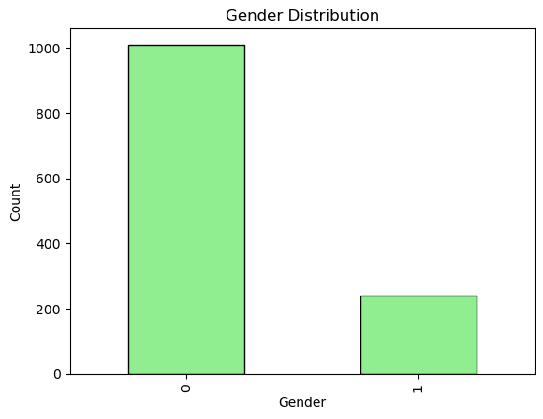
Histogramme Age and Bar Plot Gender

Slide 8
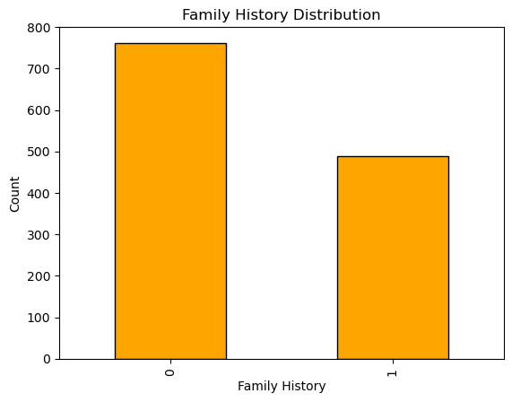
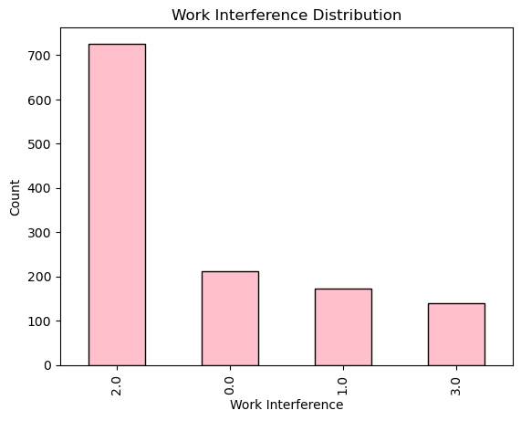
Bar plot Family history and Work interference

Slide 9
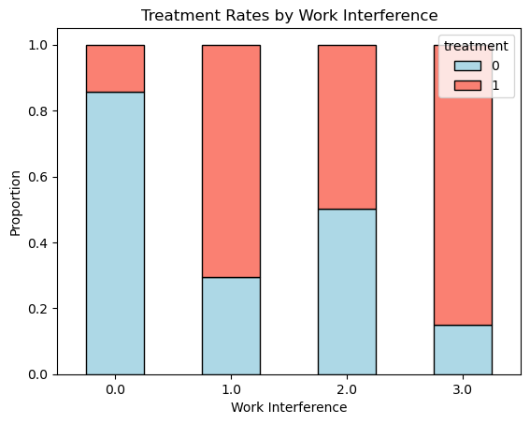
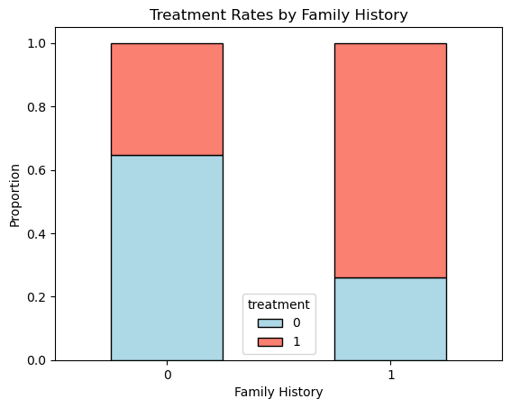
PMF Treatment Rate by Work interference and Family history

Slide 10
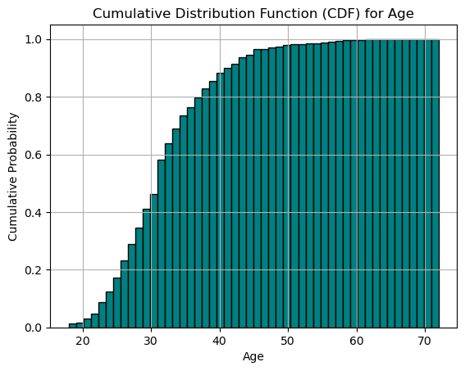
CDF for Age

Slide 11
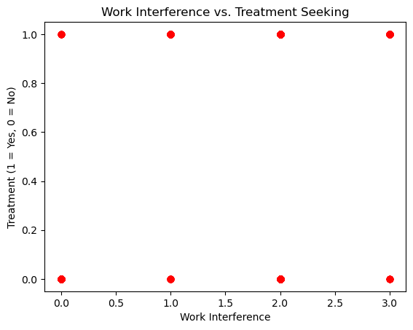
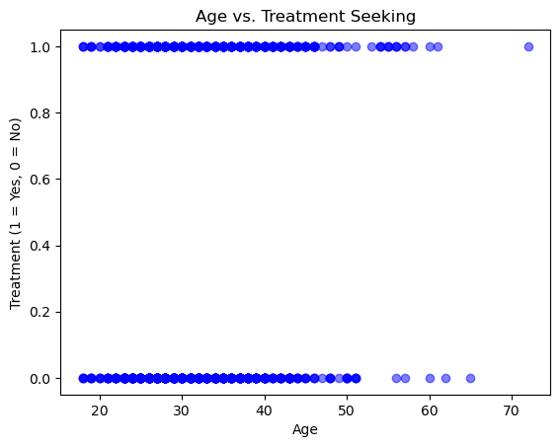
Scatter Plots

Slide 12
Findings
PMF Comparison
Treatment Rates by Family History:
Family History: 74.03% Sought Treatment, 25.97% No Treatment.
Treatment Rates by Work Interfere:
Often: 85.00% Sought Treatment, 15.00% No Treatment.
Cumulative Distribution Function (CDF):
By age 30: ~50% of respondents.
By age 40: ~80% of respondents.
Insight: Most respondents are between 20 and 40 years old.
Scatter Plots
Age vs. Treatment:
No clear linear relationship, but older employees are slightly more likely to seek treatment.
Work Interfere vs. Treatment:
Employees who report frequent work interference are more likely to seek treatment.
Insight: Work interference is a stronger predictor of treatment-seeking behavior than age

Slide 13
These findings suggest that family history and work interference are key drivers of treatment-seeking behavior
Hypothesis Testing and Regression Analysis
Chi-Square Tests:
family_history vs. treatment: χ² = 175.96, p < 0.001.
work_interfere vs. treatment: χ² = 206.63, p < 0.001.
Conclusion: Both relationships are statistically significant.
Logistic Regression Results:
Significant predictors:
family_history: Coefficient = 1.4958, p < 0.001.
Gender: Coefficient = 0.8597, p < 0.001.
work_interfere: Coefficient = 0.6832, p < 0.001.
Non-significant predictor:
no_employees: Coefficient = -0.0199, p = 0.633.

Slide 14

Conclusion
Key Findings:
Employees with a family history, females, and those experiencing frequent work interference are more likely to seek treatment.
Age has a small but significant effect.
Company size does not significantly influence treatment-seeking behavior.
Recommendations:
Workplace interventions should focus on employees with a family history or those experiencing frequent work interference.
Organizations should prioritize mental health resources for at-risk employees.
Further research could explore additional variables (e.g., income, job role).

Slide 15

Thank you!

